Slide 1
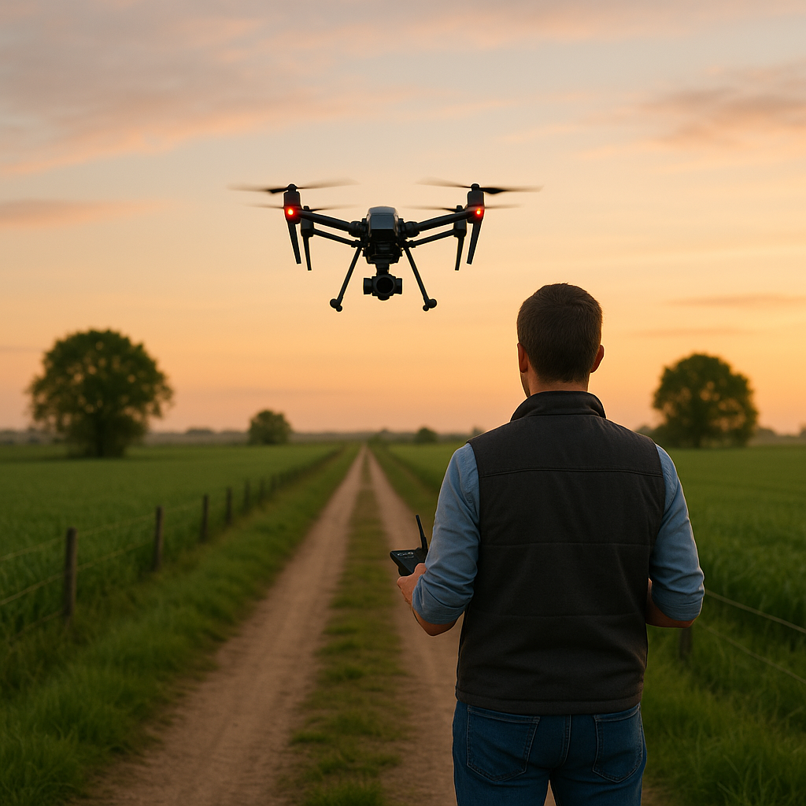

AI-Driven Business Innovation: Agricultural Sector Applications
Michael Borck, Curtin Business School

Slide 2
Today
Understanding AI Technologies - Covering the foundational technologies like machine learning, computer vision, NLP, and autonomous systems
Business Innovation Frameworks - Introducing your key frameworks like the AI Transformation Matrix and Data Value Pyramid
Implementing AI Innovation Strategies - Showing practical approaches like the Business Model Canvas and MVP methods
Ethical Considerations in AI Business Models - Addressing responsible innovation and democratization
Future Business Horizons - Exploring the Three Horizons model and future AI development timeline

Slide 3

The Business Innovation Imperative
AI isn’t just a technology upgrade—it’s a fundamental business transformation catalyst
AZI9VJ
Every industry faces disruption—agriculture provides compelling transformation examples
AI adoption represents a strategic business decision, not just a technology implementation
Business leaders must understand innovation frameworks to guide AI implementation
Today’s focus: How to apply business innovation frameworks to AI deployment in any sector
Notes:
This quote frames our entire approach today - AI is about business transformation, not just technology
Agriculture provides excellent examples because the industry is seeing dramatic and visible change
What’s happening in agriculture is a microcosm of broader business transformation
Many organisations approach AI as purely technical - this is a fundamental mistake
Success requires understanding business innovation frameworks first, then applying technology
Today I’ll show you how to approach AI implementation as a business leader, not just as a technologist
These frameworks apply to any industry - we’re using agriculture as our case study

Slide 4
PART 1: UNDERSTANDING AI TECHNOLOGIES

Slide 5
Demystifying AI: Core Technologies
Machine Learning: Systems that improve through experience
Deep Learning: Advanced pattern recognition using neural networks
Computer Vision: Enabling machines to “see” and interpret visual information
Natural Language Processing: Understanding and generating human language
Large Language Models: Advanced systems for complex language tasks
AI Agents: Autonomous systems that can perform tasks with minimal oversight
Key Business Insight: Understanding these fundamental technologies helps leaders match business problems with appropriate AI solutions
Notes:
My goal here is to make AI understandable, not mysterious
Machine Learning is about systems that learn patterns from data rather than being explicitly programmed
Think of Deep Learning as the “pattern recognition on steroids” - it can find complex relationships in data
Computer Vision is why cameras can now “see” - recognising objects, faces, conditions, or defects
NLP is what enables systems to understand and generate human language
LLMs like ChatGPT and Claude are the most advanced NLP systems, trained on massive text datasets
AI Agents are systems that can take actions somewhat independently to accomplish goals
The key insight is matching problems to technologies - not all AI is suitable for all problems
Business leaders don’t need to be technical experts but should understand these fundamental differences

Slide 6
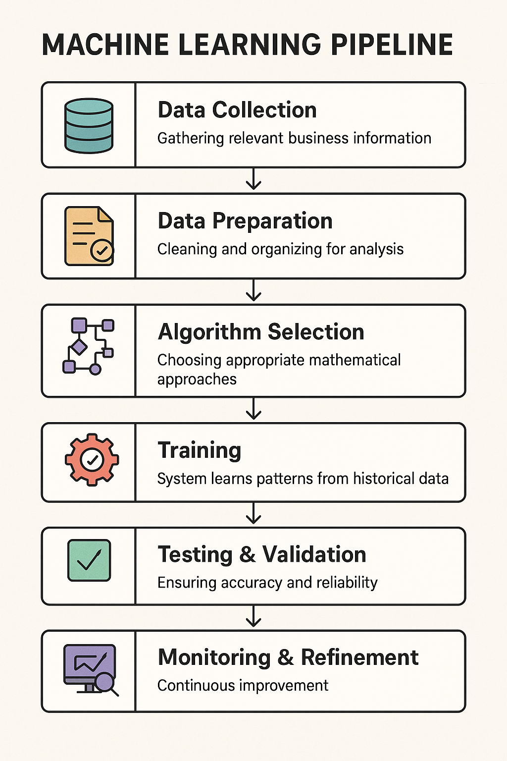
How Machine Learning Works
Key Business Insight: The quality and relevance of your data is the most critical success factor
Notes:
This slide breaks down how machine learning actually works in a business context
The process begins with data collection - you need relevant business information to learn from
Data preparation is often the most time-consuming step - garbage in, garbage out applies here
Algorithm selection means choosing the right mathematical approach for your specific problem
The training phase is where the system learnns patterns from historical data
Testing and validation ensure the system works reliably with new data
Deployment means integrating the model into actual business workflows
This isn’t “set and forget” - continuous monitoring and refinement is essential
The Google Cloud case study shows how manufacturing applies these same principles
The most important insight: data quality and relevance determine success more than algorithm sophistication
Many businesses fail with AI because they underinvest in data preparation and quality

Slide 7
Understanding the “Attention” Revolution
The Breakthrough: A 2017 paper called “Attention is All You Need” changed how AI works.
What Changed: AI systems can now look at all the information at once to find patterns and connections.
Business Analogy: It’s like going from solving problems one step at a time to seeing the whole strategy at once.
Why It Matters: AI can now understand context, relationships, and what’s most relevant — almost like a human.
How Systems Like GPT Work
Pattern Spotting: They learn by reading huge amounts of text (trillions of words).
Prediction Engine: They guess what comes next in a sentence based on what came before.
Fine-Tuning: They’re trained further to be more accurate and helpful for real-world use.
Notes:
I want to take a moment to demystify modern AI in simple business terms
The systems you hear about - ChatGPT, Claude, Gemini - are based on a breakthrough from 2017
This paper, “Attention is All You Need,” revolutionised AI by introducing the Transformer architecture
Previous AI systems processed information sequentially - like reading a book one word at a time and constantly forgetting
The breakthrough was the “attention mechanism” that lets AI instantly see connections across all information
It’s like the difference between a junior employee who needs to check the manual for every decision versus an experienced executive who instantly connects relevant information
These modern systems work in three main steps:
First, they learn patterns from massive datasets - like reading every business document ever written
Second, they function as prediction engines - you provide the beginning of a pattern, they predict the most appropriate continuation
Third, they have an alignment layer - additional training to make them helpful, factual, and appropriate
Understanding this helps business leaders see why these systems are fundamentally different from previous technologies
They weren’t programmed with rules, they learned patterns - which explains both their remarkable capabilities and their limitations
This isn’t just a technical detail - it has profound implications for how you implement AI in your organisation

Slide 8
AI Limitations & Implementation Challenges
Dimension | Key Limitations | Business Implications | Mitigation Strategies
Technical Reality | - Hallucinations and fabrications- Reasoning limits- Knowledge cutoffs- Black-box models | - Unreliable outputs- Can’t replace human judgment- Integration required- Opaque decisions | - Robust verification- Augment, don’t automate- Hybrid systems- Invest in explainable AI
Organizational Challenges | - Workforce skills gap- Legacy systems- Data issues- Exec buy-in gaps | - Slow adoption- Value trapped- High failure rates- ROI/expectation mismatch | - Build capabilities- Target high-value use cases- Fix data foundations- Value frameworks
Ethical & Risk Dimensions | - Bias & unfairness- Privacy/security risks- Regulatory complexity- Environmental impact | - Legal/reputation risks- Trust erosion- Compliance burdens- Sustainability concerns | - Responsible AI governance- Bias audits- Track regulations- Optimize for efficiency
Notes:
While I’ve emphasized AI’s transformative potential, it’s equally important to understand its real limitations and implementation challenges.
Technical Limitations:
Hallucinations remain a significant issue - AI systems confidently generate incorrect information that appears plausible, which creates verification challenges.
Current AI has fundamental reasoning limitations, especially with complex logical, mathematical, or causal reasoning tasks.
Knowledge cutoffs mean systems lack current information unless specifically integrated with real-time data sources.
The black-box nature of large models makes it difficult to understand why specific outputs are generated.
These limitations mean human verification remains essential, and we should focus on augmentation rather than full automation.
Organizational Challenges:
The skills gap isn’t just technical - it includes the business capabilities needed to identify valuable use cases and manage implementation.
Integration with existing systems is often more challenging than the AI technology itself.
Data quality issues frequently derail AI initiatives - algorithms can’t overcome fundamentally flawed data.
McKinsey research shows that 80% of AI initiatives struggle to move beyond pilot phase due to these organizational barriers.
The practical approach is starting with targeted use cases that have clear value and building from there.
Ethical and Risk Dimensions:
Bias amplification occurs when AI systems learn from and then magnify existing biases in training data.
Privacy concerns include both the data needed to train systems and the potential exposure of sensitive information in outputs.
Regulatory landscape is evolving rapidly, creating compliance uncertainty and potential legal exposure.
The environmental impact of large AI models is substantial - training a single large model can generate as much carbon as five cars over their lifetimes.
Organizations need proactive governance frameworks that address these concerns before they become problems.
Key Takeaway:
Successful AI implementation requires clear-eyed recognition of these limitations.
The frameworks we’ve discussed provide structure for navigating these challenges.
Organizations that acknowledge and plan for these limitations ultimately achieve better results than those with unrealistic expectations.
This isn’t about dampening enthusiasm but ensuring that it’s channeled productively.

Slide 9
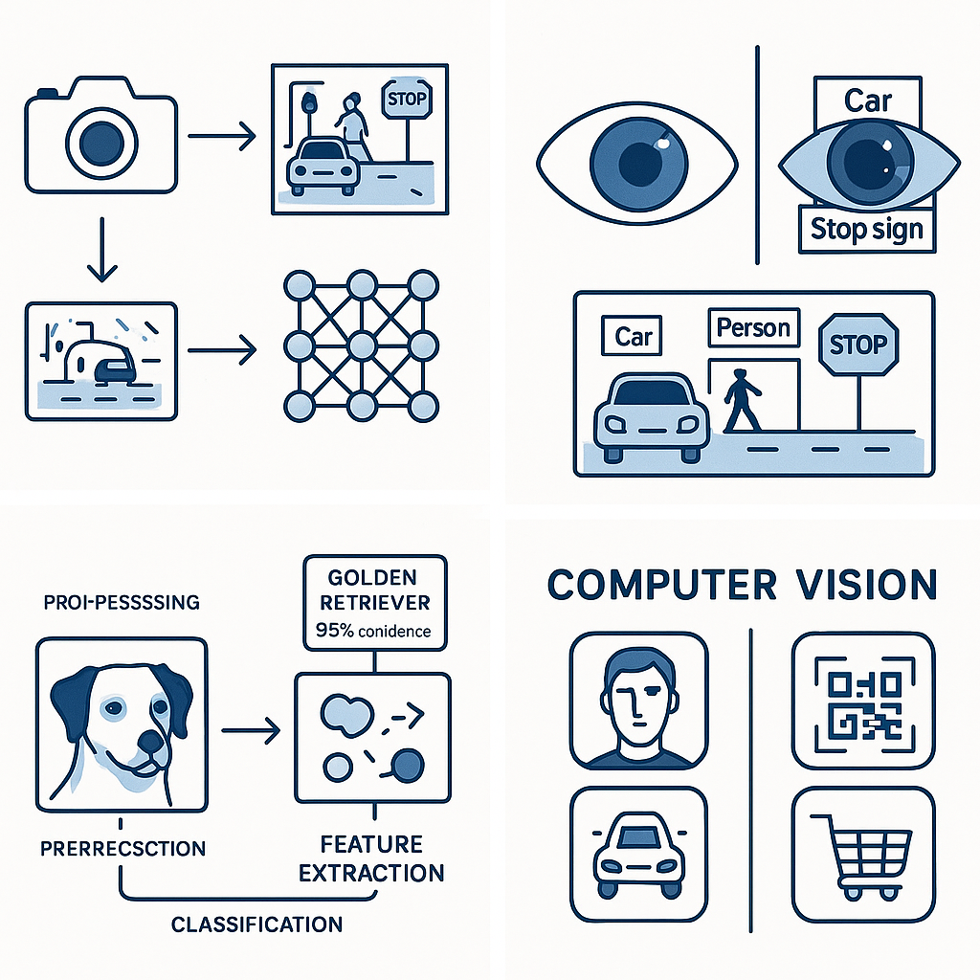
Computer Vision in Business
Enabling Machines to “See” for Business Value:
How It Works: Uses neural networks to identify objects, features, and patterns in images/video
Common Techniques: Object detection, image classification, segmentation, tracking
Hardware Requirements: Specialised processors (GPUs) for efficient processing
Deployment Options: Edge devices, cloud processing, hybrid approaches
Agricultural Application: Smart spraying systems that reduce herbicide use by 80-96% by identifying individual weeds
Source: ABC News, “AI helps Aussie farmers target weeds,” 2024
Computer Vision Example
Notes:
Computer vision enables machines to “see” and interpret visual information
At its core, neural networks analyse pixel patterns to identify objects and features
It works through techniques like object detection (finding things), classification (identifying what they are), segmentation (outlining objects precisely), and tracking (following objects over time)
These systems typically require specialised hardware - regular computers struggle with this processing
Deployment can happen on-device (edge), in the cloud, or in hybrid approaches
The agricultural example is powerful - smart spraying systems use computer vision to only spray herbicide on weeds, not crops
The 80-96% reduction in herbicide use is not just environmental but has massive cost implications
This technology applies across industries - manufacturing quality control, retail analytics, security
The Microsoft FarmBeats case study provides additional context on real-world applications
The business value extends far beyond the technical capabilities - it transforms operations

Slide 10
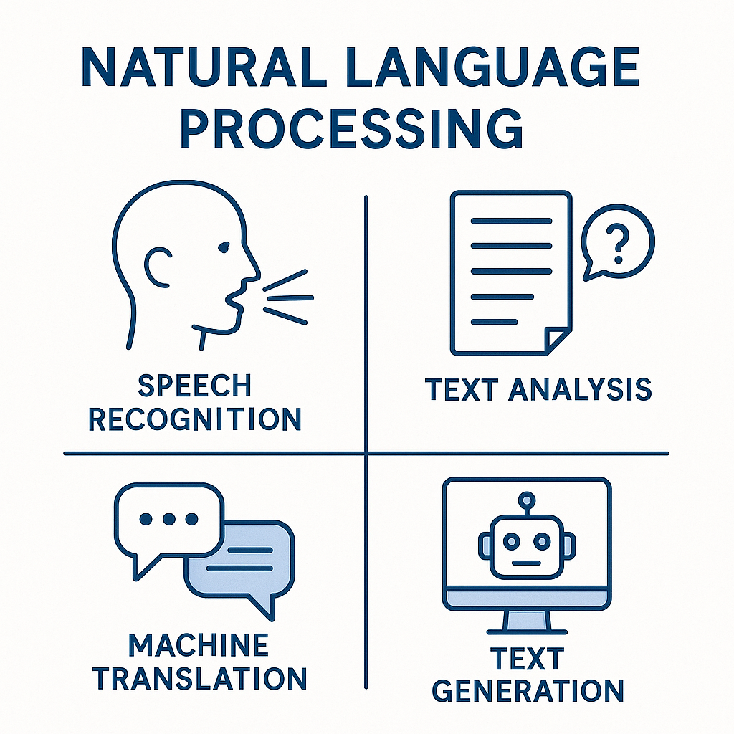
Natural Language Processing & LLMs
Transforming How Businesses Work with Language:
How NLP Works: Analyses, understands and generates human language
Key Capabilities: Sentiment analysis, information extraction, summarisation, translation
How LLMs Work: Trained on massive text datasets to predict and generate human-like text
Business Applications: Content generation, research assistance, customer service, decision support
Agricultural Application: Farm management planning tools that process complex regulations and research
NLP Capabilities Diagram
Notes:
Natural Language Processing represents one of the most transformative AI capabilities for business
At a basic level, NLP analyses and understands human language through complex pattern recognition
Traditional capabilities include sentiment analysis (understanding emotion), information extraction (pulling key facts), summarisation, and translation
Large Language Models like ChatGPT and Claude represent a quantum leap in capabilities
LLMs work by being trained on massive text datasets to predict what text should come next
This predictive capability allows them to generate remarkably human-like text and reasoning
Business applications are extensive - content creation, research analysis, customer service, and decision support
The agricultural example shows how LLMs can process complex regulations and research that would overwhelm humans
This same capability applies to legal compliance, market research, and competitive intelligence in any industry
The Deloitte guide provides implementation frameworks that transfer across business domains
The key business insight is that LLMs are most valuable when integrating human expertise with AI capabilities

Slide 11
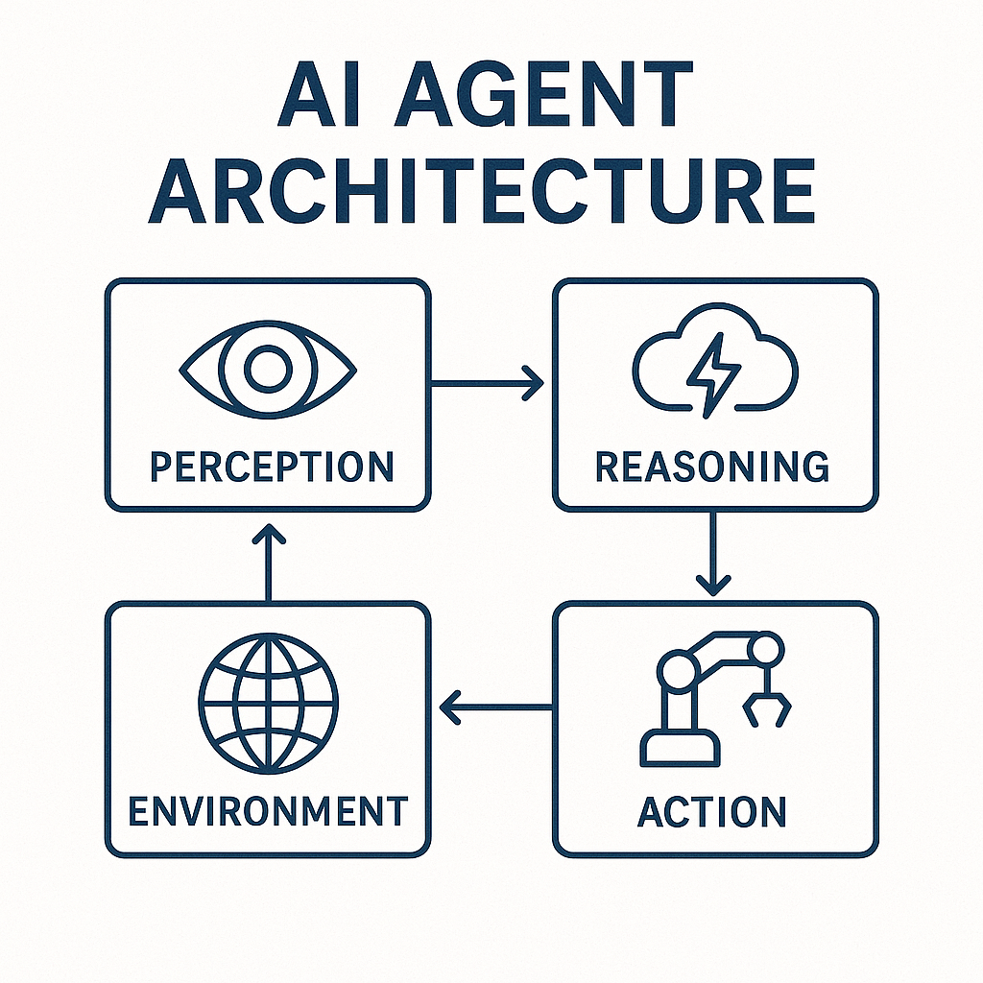
AI Agents & Autonomous Systems
Business Applications of Self-Directing AI:
How They Work: Systems that can sense, decide, and act with minimal human intervention
Key Components: Perception modules, decision-making logic, action capabilities
Implementation Approaches: Rules-based, learning-based, hybrid systems
Current Limitations: Defined scope, supervision requirements, handling exceptions
Agricultural Application: Autonomous tractors and harvesters in “hands-free” farming operations
AI Agent Architecture
Notes:
AI agents represent the frontier of business applications - systems that can independently pursue objectives
They work by combining three key capabilities: sensing (perceiving the environment), deciding (choosing actions), and acting (implementing decisions)
The architecture typically includes perception modules that interpret the world, decision logic that determines actions, and capabilities to carry out those actions
Implementation can be rules-based (following predefined instructions), learning-based (adapting through experience), or hybrid
Current limitations are important to understand - most agents work within defined scopes, require supervision, and struggle with exceptional cases
The agricultural example of autonomous tractors shows this in action - they can perform complex field operations with minimal supervision
This same principle applies to autonomous systems in manufacturing, logistics, customer service, and financial operations
The McKinsey case study provides a broader business perspective on implementation approaches
The key insight is that autonomous systems aren’t about replacing humans but augmenting capabilities and freeing people for higher-value work
The most successful implementations start with narrow, well-defined applications before expanding scope

Slide 12
PART 2: BUSINESS INNOVATION FRAMEWORKS
AZI9VJ

Slide 13
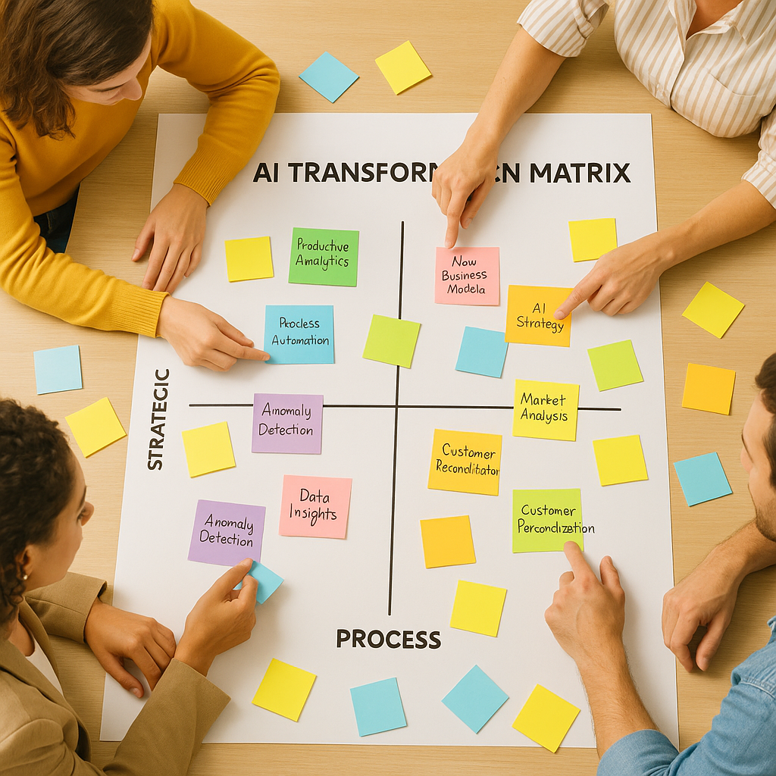
The AI Transformation Matrix
 | Incremental | Transformational
Process Improvement | Efficiency Gains | Business Process Reengineering
Strategic Innovation | New Capabilities | Business Model Reinvention
Agricultural Example:
Smart spraying (80-96% chemical reduction) started as efficiency gain but led to business model reinvention through sustainability certification premiums
Source: ABC News, “AI helps Aussie farmers target weeds,” 2024
Notes:
The AI Transformation Matrix helps organisations map their AI initiatives based on impact type and scale
The vertical axis represents the focus - are you improving processes or creating strategic innovation?
The horisontal axis represents the magnitude - are the changes incremental or transformational?
Most organisations start in the upper left - efficiency gains - which is appropriate but limited
The smart spraying example shows the journey across this matrix
It began as an efficiency play - reducing herbicide costs by 80-96% by only spraying actual weeds
But it evolved into business model reinvention - enabling premium pricing through sustainability certification
This pattern applies across industries - what starts as efficiency often leads to transformation
The most successful organisations deliberately plan movement across this matrix over time
The Deloitte framework provides additional context on implementing this approach
This matrix helps executives communicate the strategic intent of AI initiatives and set appropriate expectations
Ask yourself: Where do your current AI initiatives fall? Are you limiting yourself to the efficiency quadrant?

Slide 14
The Data Value Pyramid
Turning Information into Business Value:
Descriptive Analytics: What happened? (Data collection)
Diagnostic Analytics: Why did it happen? (Data interpretation)
Predictive Analytics: What will happen? (Data forecasting)
Prescriptive Analytics: What should we do? (Data-driven decisions)
Cognitive Analytics: Self-optimising systems (Autonomous operations)
Agricultural Example: Livestock monitoring evolution from basic tracking → health predictions → autonomous intervention systems. Source: CSIRO, “Ceres Tag smart ear tags,” 2023
Notes:
The Data Value Pyramid shows how organisations extract increasing value from their data
Most organisations start at the bottom with descriptive analytics - simply understanding what happened
Diagnostic analytics adds interpretation - why did these events occur?
Predictive analytics moves into forecasting - what is likely to happen next?
Prescriptive analytics recommends actions - what should we do about it?
Cognitive analytics represents the frontier - systems that can optimise themselves
The livestock monitoring example shows this evolution perfectly
It began with basic GPS tracking of cattle (descriptive - where are they?)
Advanced to health monitoring that could diagnose issues (why is this animal behaving differently?)
Then to predictive systems that could forecast health problems before visible symptoms
Now moving toward systems that can prescribe and even implement interventions
This same progression applies to any data-driven business function
The key insight: higher levels of the pyramid deliver exponentially more business value
Most organisations get stuck at descriptive/diagnostic levels and never realise the full potential
The Gartner model provides a framework for assessing your current maturity and planning advancement
Where is your organisation on this pyramid? What would it take to move up one level?

Slide 15
The Innovation Adoption Framework
Five Business Implementation Phases:
Knowledge Building: Understanding potential and possibilities
Strategic Alignment: Connecting AI to business objectives
Capability Development: Building human and technical resources
Pilot Implementation: Testing and proving value
Organisational Transformation: Scaling and integrating across business
Agricultural Example: How Digital Agriculture Services (DAS) progressed through these phases when implementing their crop forecasting system - Additional coverage: IT Brief article
Notes:
The Innovation Adoption Framework provides a roadmap for implementing AI in organisations
Phase 1 is Knowledge Building - understanding what’s possible before making commitments
Phase 2 is Strategic Alignment - connecting AI initiatives to specific business objectives
Phase 3 is Capability Development - building or acquiring the needed skills and technologies
Phase 4 is Pilot Implementation - testing in controlled environments to demonstrate value
Phase 5 is Organisational Transformation - scaling successful approaches across the business
The Digital Agriculture Services example illustrates this progression
They began by building knowledge about how satellite imagery and ML could predict crop yields
They aligned this with strategic business needs in agricultural insurance and investment
They developed capabilities by building data science teams and satellite imagery processing
Their pilot implementations tested predictions against ground-truth data in specific regions
Now they’re transforming the agricultural intelligence landscape at organisational scale
This framework applies to any significant innovation initiative, not just AI
The key insight: skipping phases often leads to implementation failure
Many organisations jump straight to pilots without strategic alignment or capability building
The KPMG framework provides additional detail on implementing each phase
What phase is your organisation currently in? Are you trying to skip essential steps?

Slide 16
The AI Investment Model
Calculating Return on AI Investment:
Cost Considerations: Implementation, integration, training, maintenance
Value Categories: Efficiency gains, new capabilities, risk reduction, market differentiation
Measuring Success: KPIs, benchmarks, and value capture mechanisms
Timeline Expectations: Short-term wins vs. long-term transformation
Agricultural Example: AgBot II autonomous weeding robot’s ROI calculation model and payback period analysis. Source: Queensland University of Technology, “AgBot II Robot for Farm Weed Management”
Notes:
The AI Investment Model provides a framework for calculating the business value of AI initiatives
Cost considerations include not just implementation but integration with existing systems, staff training, and ongoing maintenance
Value categories are diverse - efficiency gains are most obvious, but new capabilities, risk reduction, and market differentiation often deliver greater value
Measuring success requires specific KPIs tailored to your business objectives
Timeline expectations are crucial - some benefits appear quickly while transformational value takes longer
The AgBot II example demonstrates this comprehensive approach to ROI calculation
Initial costs included development, manufacturing, and implementation
Value categories included reduced herbicide costs, labor savings, and yield improvements
Their measurement approach compared traditional methods to autonomous operations
Timeline expectations recognised short-term operational savings and long-term transformation of weed management
The projected AU$1.3 billion national impact shows the scaling potential
This same model applies to AI investments in any business domain
The key insight: comprehensive ROI calculations require looking beyond obvious cost savings
Most organisations underestimate both costs (especially integration) and benefits (especially strategic value)
The HBR article provides additional frameworks for calculating generative AI ROI
How comprehensive is your current approach to AI investment calculations?

Slide 17
PART 3: IMPLEMENTING AI INNOVATION STRATEGIES

Slide 18
Strategy 1: The Business Model Canvas for AI Integration
Key Components:
Problem-Solution Fit: Identify specific business challenges AI can address
Value Proposition Canvas: Define clear value added through AI
Resource Assessment: Gap analysis of capabilities needed
Cost-Benefit Structure: Comprehensive ROI model
Agricultural Application: How Wagga Wagga “hands-free” farm used this canvas to develop their autonomous farming business case. ABC News: Automated Farm
Notes:
The Business Model Canvas provides a structured approach to integrating AI into business models
Problem-Solution Fit ensures you’re addressing actual business challenges, not just deploying technology
The Value Proposition Canvas helps articulate exactly what value AI adds for customers and the business
Resource Assessment identifies capability gaps in technology, data, expertise, and infrastructure
Cost-Benefit Structure creates a comprehensive model of investment and returns
The Wagga Wagga “hands-free” farm applied this approach to autonomous farming
They identified specific problems - labor shortages, precision limitations, and management complexity
Their value proposition focused on higher yields, reduced inputs, and consistent quality
Their resource assessment identified gaps in technical infrastructure and staff capabilities
Their cost-benefit structure modeled initial investment against multi-year productivity gains
This systematic approach helped secure funding and stakeholder support
The same canvas framework applies to AI integration in any industry
The key insight: successful AI implementation begins with business model clarity, not technology selection
The Strategyser reference provides templates and examples for applying this canvas
How might this canvas help structure your organisation’s approach to AI integration?

Slide 19
Strategy 2: The MVP (Minimum Viable Product) Approach
Framework Elements:
Scope Definition: Select high-impact, low-complexity starting point
Success Metrics: Define clear KPIs tied to business outcomes
Feedback Loops: Structured learning mechanisms
Scaling Plan: Path from pilot to enterprise implementation
Agricultural Application: CQUniversity’s staged approach to weed-targeting drone deployment. Source: CQUniversity, “Autonomous weed-targeting AI drones a sky-high success”
Framework Reference: Lean Startup Methodology
Notes:
The MVP (Minimum Viable Product) Approach applies lean startup methodology to AI implementation
Scope Definition means selecting a narrow, high-impact use case for initial implementation
Success Metrics establish clear, measurable KPIs tied directly to business outcomes
Feedback Loops create structured mechanisms for learning and adaptation
The Scaling Plan maps the path from successful pilot to enterprise-wide implementation
CQUniversity applied this approach to their weed-targeting drone project
They defined a narrow initial scope - identifying a single weed species in sorghum crops
Their success metrics included detection accuracy, reduction in herbicide use, and time savings
They established feedback loops through field testing and farmer interviews
Their scaling plan expanded to additional weed species, crop types, and geographic regions
This staged approach reduced risk while demonstrating value at each step
The same MVP methodology applies to AI implementation in any domain
The key insight: starting small but strategically creates momentum and builds credibility
Many organisations fail by attempting too much too soon without proving value
The Lean Startup reference provides additional context on applying this methodology
Could your organisation benefit from a more focused MVP approach to AI implementation?

Slide 20
Strategy 3: The Capability Building Roadmap
Framework Components:
Skills Assessment: Current vs. required capabilities
Build-Buy-Partner Decisions: Sourcing strategy for AI capabilities
Training and Development Plan: Upskilling existing workforce
Organisational Structure Evolution: New roles and responsibilities
Agricultural Application: How Northern Territory cattle stations developed internal capabilities for GPS collar data analysis. Source: CSIRO’s livestock monitoring research
Notes:
The Capability Building Roadmap addresses the human and organisational aspects of AI implementation
Skills Assessment maps current capabilities against those required for AI transformation
Build-Buy-Partner Decisions determine whether to develop internal capabilities, acquire them, or partner
Training and Development Plans establish how to upskill the existing workforce
Organisational Structure Evolution identifies new roles, reporting relationships, and governance models
The Northern Territory cattle stations example demonstrates this approach
They began by assessing existing skills against those needed for GPS collar data analysis
They decided to build core analytical capabilities internally while partnering for technical infrastructure
They developed training programs for station managers to interpret movement patterns
They evolved their organisational structure to include data analysts and GIS specialists
This capability-focused approach ensured sustainable implementation beyond initial deployment
The same roadmap applies to building AI capabilities in any organisation
The key insight: technology implementation without capability building leads to dependence and limited value
Many organisations underinvest in the human and organisational dimensions of AI
The Deloitte framework provides additional context on capability development approaches
How comprehensive is your organisation’s capability building roadmap for AI?

Slide 21
Strategy 4: The Data Strategy Blueprint
Framework Elements:
Data Inventory: Assessing available and needed data sources
Data Quality Framework: Ensuring reliable inputs for AI systems
Data Governance Model: Managing ownership and access rights
Privacy and Ethics Guidelines: Responsible data practices
Agricultural Application: Australian Farm Data Code implementation by agtech providers. Source: National Farmers’ Federation (NFF)
Framework Reference: MIT Sloan Data Strategy Framework
Notes:
The Data Strategy Blueprint addresses the foundation of effective AI implementation
Data Inventory assesses what data you have, what you need, and identifies gaps
The Data Quality Framework ensures reliable, consistent inputs for AI systems
Data Governance Models manage ownership, access rights, and usage policies
Privacy and Ethics Guidelines establish responsible practices for data collection and use
The Australian Farm Data Code implementation demonstrates this approach
Agricultural technology providers created comprehensive inventories of farm data sources
They established quality standards for data collection and processing
They implemented governance models that preserved farmer ownership of data
They developed ethical guidelines for responsible data use and sharing
This systematic approach built trust while enabling innovation
The same blueprint applies to data strategy in any industry
The key insight: data strategy must precede AI implementation for sustainable success
Many organisations jump to AI implementation without addressing fundamental data issues
The MIT Sloan framework provides additional context on developing data strategies
How comprehensive is your organisation’s data strategy? Is it an afterthought or a foundation?

Slide 22
PART 4: ETHICAL CONSIDERATIONS IN AI BUSINESS MODELS

Slide 23
The Responsible Innovation Framework
Core Business Principles:
Transparency: Explainable AI for stakeholder trust
Accountability: Clear responsibility for AI systems
Fairness: Equitable access and benefits across business scales
Sustainability: Long-term environmental and social impacts
Agricultural Application: Ethical considerations in autonomous farming systems
Framework Reference: Australia’s AI Ethics Framework , IEEE Ethically Aligned Design
Notes:
The Responsible Innovation Framework establishes principles for ethical AI implementation
Transparency means making AI systems explainable to build stakeholder trust
Accountability establishes clear responsibility for AI decisions and actions
Fairness ensures equitable access and benefits across different organisational scales
Sustainability addresses long-term environmental and social impacts
The autonomous farming systems example demonstrates these principles in action
Transparency in how autonomous systems make decisions about field operations
Accountability through clear human oversight and intervention capabilities
Fairness considerations for accessibility to farms of different sises and resource levels
Sustainability focus on environmental impacts and rural community effects
These principles helped guide implementation choices and system design
The same framework applies to responsible AI innovation in any industry
The key insight: ethical considerations should be built in from the beginning, not added later
Organisations that integrate ethics into design avoid costly redesigns and reputation damage
The IEEE framework provides additional guidance on ethically aligned design
How are ethical considerations integrated into your organisation’s AI strategy?

Slide 24
The Technology Democratisation Model
Business Framework for Inclusive Innovation:
Access Mechanisms: How smaller businesses can leverage AI
Capability Building: Community-based knowledge sharing
Cooperative Models: Shared resources and infrastructure
Policy Considerations: Supporting ecosystem development
Agricultural Application: Cooperative AI implementation models for family farms - Case Study: Birchip Cropping Group’s shared technology model
Notes:
The Technology Democratisation Model addresses how to make AI accessible across organisation sises
Access Mechanisms are approaches that enable smaller businesses to leverage advanced AI
Capability Building focuses on community-based knowledge sharing and skill development
Cooperative Models enable shared resources and infrastructure to distribute costs
Policy Considerations address ecosystem development to support inclusive innovation
The family farm cooperative example demonstrates this approach
Access mechanisms included subscription-based AI services with minimal upfront investment
Capability building happened through farmer-to-farmer knowledge networks
Cooperative models shared equipment costs and data infrastructure
Policy advocacy influenced research funding and connectivity infrastructure
This democratic approach ensured benefits weren’t limited to the largest players
The same model applies to technology democratisation in any industry
The key insight: inclusive innovation approaches strengthen entire ecosystems
Organisations that support democratisation often benefit from network effects and ecosystem growth
The WEF framework provides additional context on inclusive technology development
How might your organisation contribute to more democratic access to AI capabilities?

Slide 25
PART 5: FUTURE BUSINESS HORIZONS

Slide 26
The Three Horisons of AI Innovation
Horison 1 (Next 2 Years): Extending and defending core business
Implementing proven AI technologies for immediate gains
Example: Smartphone-based decision support tools
Source: iGrowNews, “Australian Farmers Embrace AgTech,” 2024
Horison 2 (2-5 Years): Building emerging opportunities
Investing in developing capabilities and new business models
Example: Integrated “smart farm” management systems
Horison 3 (5-10 Years): Creating viable options for future business
Exploring breakthrough possibilities and industry transformation
Example: Autonomous farms with minimal human intervention
Source: Food Agility CRC Future Vision
Key Business Insight: Balanced investment portfolio across all three horizons is essential for sustainable innovation
Notes:
The Three Horisons model provides a framework for balanced innovation planning
Horison 1 focuses on the next 2 years - extending and defending the core business
This includes implementing proven AI technologies for immediate business gains
In agriculture, this means smartphone-based decision support tools already being adopted
Horison 2 looks at the 2-5 year timeframe - building emerging opportunities
This involves developing capabilities and new business models with growing evidence
The integrated “smart farm” systems represent this horison - proven in concept but not yet mainstream
Horison 3 addresses the 5-10 year future - creating viable options for future business
This explores breakthrough possibilities that could transform industries
Fully autonomous farming operations exemplify this horison - technically possible but not yet practical
The key insight is that organisations need a balanced portfolio across all three horisons
Most organisations overinvest in Horison 1 and underinvest in Horisons 2 and 3
This leaves them vulnerable to disruption and missing future opportunities
The McKinsey model provides additional guidance on portfolio allocation
How balanced is your organisation’s innovation portfolio across these three horisons?

Slide 27
AI Next 2 yrs
Time Horizon | Technical Evolution | Business Impact | Society & Governance
Next 2 Years(2025-2027)Expansion & Consolidation | • Advanced multimodal models• Smaller, efficient models for edge devices• Domain-specialized AI systems• Early agentic AI | • Productivity gains in knowledge work• Integration into enterprise workflows• Software development disruption• Focus on ROI and practical applications | • First comprehensive AI regulations• Growing emphasis on transparency• AI literacy becoming essential• Educational adaptation
Notes:
This timeline provides a strategic perspective on AI evolution over the next decade, organized using the Three Horizons framework we discussed earlier.
For the Next 2 Years (2025-2027) - “Expansion & Consolidation”:
Technically, we’re seeing multimodal models becoming standard, not just handling text but processing and generating across multiple formats simultaneously.
The business focus is pragmatic - organizations are prioritizing measurable ROI and practical applications rather than experimental use cases.
The key development in governance is the implementation of first-generation comprehensive regulations, similar to what we’re seeing with the EU AI Act but with global variations.
This period represents enhancement of current business models rather than fundamental transformation.

Slide 28
AI Next 2-5 yrs
Time Horizon | Technical Evolution | Business Impact | Society & Governance
2-5 Years(2027-2030)Systems Integration & Transformation | • AI agents with memory and reasoning• Personalized AI assistants• AI-native applications• Next-gen hardware deployment | • “Co-pilot for everything” reality• Major industry disruption• Job transformation• New AI-enabled business models | • Mature international standards• Ethical governance frameworks• AI accelerating scientific discovery• Workforce reskilling priority
Notes:
For the Medium Term (2027-2030) - “Systems Integration & Transformation”:
The technical evolution moves toward truly agentic systems - AI that can reason across context, maintain memory, and operate with limited autonomy.
Business impact shifts from enhancing current processes to transforming them - we’ll see “co-pilots” for virtually every knowledge work domain.
This will drive significant job transformation - not primarily elimination but redefinition of roles around AI collaboration.
Governance frameworks mature from reactive to proactive, with established international standards similar to what we’ve seen with data privacy.

Slide 29
AI Next 5-10 yrs
Time Horizon | Technical Evolution | Business Impact | Society & Governance
5-10 Years(2030-2035)AI-Native Society & Reinvention | • General-purpose AI systems• Potential AGI emergence• Quantum-AI synergies• Advanced human-AI interfaces | • Economic structural changes• High-level cognitive automation• New career categories• AI as critical infrastructure | • Global AI governance treaties• Redefined creativity concepts• Existential risk management• Philosophical reassessment
Notes:
For the Long Term (2030-2035) - “AI-Native Society & Reinvention”:
While I’ve included potential AGI emergence, this remains speculative - what’s more certain is the development of increasingly general-purpose systems.
The business landscape undergoes structural changes as AI becomes critical infrastructure - similar to how the internet transformed from advantage to necessity.
We’ll likely see entirely new career categories emerge rather than just automation of existing ones.
Governance shifts to treaty-level international frameworks addressing existential concerns.
This period also brings deeper philosophical questions about human-AI relationships and creativity.
Key Strategic Implications:
Organizations need balanced investment portfolios across all three horizons.
Near-term focus should be on practical applications with measurable ROI.
Medium-term planning should involve business model innovation and workforce transformation.
Long-term vision should consider fundamental shifts in how value is created and delivered.
Each industry will experience this timeline differently, with some sectors transforming faster than others.
For Your Organization:
Consider where your current AI initiatives fall on this timeline.
Are you overly focused on Horizon 1 at the expense of preparing for Horizons 2 and 3?
Have you considered the talent and capability implications of each horizon?
How might your competitive landscape change as AI evolves across these timeframes?

Slide 30
Conclusion
AI implementation is fundamentally a business transformation opportunity
Strategic frameworks transform technology potential into business value
The path from concept to implementation requires structured approaches
Your competitive advantage lies in how you implement, not just what you implement
The organizations that thrive won’t merely adopt AI technologies—they’ll master the frameworks that transform those technologies into strategic advantage
Notes:
As we conclude our exploration of AI-driven business innovation, I want to emphasize the tremendous opportunity ahead
Throughout this masterclass, we’ve seen that successful AI implementation isn’t primarily a technical challenge—it’s a strategic business transformation opportunity
The frameworks we’ve explored today provide the architecture for that transformation, regardless of your industry or organization size
While we’ve drawn examples from agriculture for their clarity and impact, these same frameworks apply whether you’re in manufacturing, healthcare, finance, retail, or any other sector
The agricultural examples demonstrate how the same technology can yield dramatically different outcomes based on implementation approach
I encourage you to reflect on which frameworks resonate most with your specific business challenges:
Perhaps the AI Transformation Matrix helps you map your current initiatives
Or the Three Horizons model provides structure for your innovation portfolio
Or the Data Value Pyramid helps articulate your analytics progression
What makes these frameworks powerful is their ability to create organizational alignment, focus resources, and build sustainable capability
Organizations with identical access to AI technologies achieve vastly different results based on how strategically they implement
As you consider your next steps:
Which framework will you apply first in your organization?
What immediate opportunity do you see to create value?
How might you build a more structured approach to AI innovation?
The future belongs to organizations that master not just the technology but the strategic frameworks that guide implementation
I’m excited to see the innovation journeys you’ll embark on, and I welcome your questions about applying these frameworks to your specific challenges
Thank you for your engagement today

Slide 31
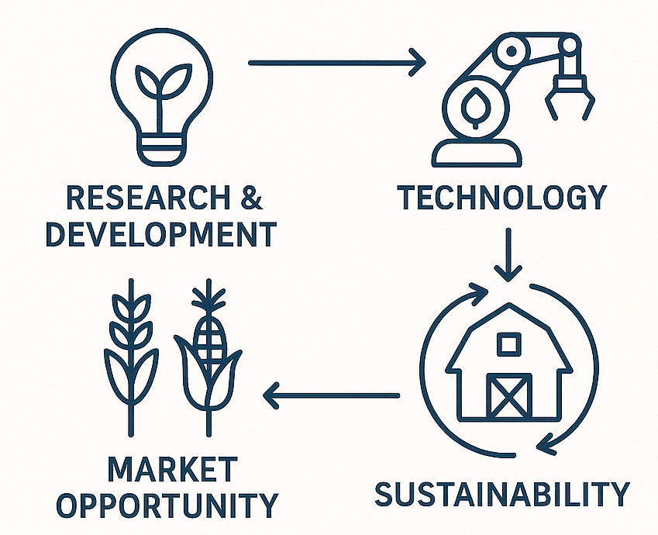
Questions
Dr. Michael Borck
Curtin Business School
michael.borck@curtin.edu.au
linkedin.com/in/michael-borck
Business innovation diagram with agricultural elements
Notes:
Please feel free to reach out after the masterclass
I’m happy to discuss specific business innovation challenges
Or to provide additional frameworks relevant to your industry
Connect with me on LinkedIn for ongoing insights on AI business innovation
I regularly share case studies and implementation frameworks there
Thank you again for your participation and engagement today
Thank you all for your attention and engagement
I hope you leave with practical frameworks you can apply immediately
Remember that successful AI implementation is about business innovation first, technology second
Agriculture provides compelling examples, but these frameworks are universally applicable
I look forward to hearing how you apply these approaches in your organisations
Safe travels and best wishes for your AI innovation journeys

